Slide 1
Linux Essentials
Chapter 8:
Searching, Extracting, and Archiving Data

Slide 2
Chapter 8 Outline
Using regular expressions
Searching for and extracting data
Redirecting input and output
Archiving data

Slide 3
Using Regular Expressions
Basic Regular Expressions (BRE)
Bracket expressions
  b[aeiou]g
  b[^aeiou]g
Range expressions
  ma[m-p]
Any single character
  s.n

Slide 4
Using Regular Expressions
(continued)
Basic Regular Expressions
Bracket expressions
Range expressions
Any single character
Start and end of line
  ^
  $

Slide 5
Using Regular Expressions
(continued)
Basic Regular Expressions
Bracket expressions
Range expressions
Any single character
Start and end of line
Repetition
  * Preceding character present zero or more time
  .* Match any substring
    LPI.*Certification
Escaping: \

Slide 6
Using Regular Expressions
(continued)
Basic Regular Expressions
Extended Regular Expressions (ERE)
Additional repetition operators
  + Preceding character present one or more times
  ? Preceding character present zero or one times
Multiple possible strings
  car|truck
Parentheses
  (c|b)a(b|t)

Slide 7
Searching for and Extracting Data
Using grep
Searches specified file(s) for a specified string
Returns file record containing string
Examples:
  grep root /etc/passwd
  grep root /etc/*
  grep –i root /etc/*
  grep ^root /etc/passwd

Slide 8
Searching for and Extracting Data
Using grep
Searches specified file(s) for a specified string
Returns file record containing string
Examples
Shell Quoting
  Enclose certain regular expressions in quotes
  Shell uses certain characters, for its own purposes, such as:
    vertical bar: |
    Asterisk: *
  grep -E "(games|mail).*nologin" /etc/passwd

Slide 9
Common grep Options
Option (long form) | Option (short form) | Description
--count | -c | Instead of displaying the lines that contain matches to the regular expression, display the number of lines that match.
--file=file | -f file | This option takes pattern input from the specified file rather than from the command line. The fgrep command is a shortcut for this option.
--ignore-case | -i | You can perform a case-insensitive search, rather than the default case-sensitive search, by using the -i or --ignore-case option.
--recursive | -R or -r | This option searches in the specified directory and all subdirectories rather than simply the specified directory. You can use rgrep rather than specify this option.
--extended-regexp | -E | The grep command uses basic regular expressions by default. To use an extended regular expression, you can pass this option. Alternatively, you can call egrep rather than grep; this variant command uses extended regular expressions by default.

Slide 10
Searching for and Extracting Data
(continued)
Using grep
Using find
Searches specified directory tree for specified item
Returns absolute directory reference and filename
Syntax:
find starting_point_directory options
Examples:
  find /etc -name passwd
  find / -user fred

Slide 11
Common find Search Criteria
Option | Description
-name pattern | You can search for files using their names with this option. Doing so finds files that match the specified pattern. This pattern is not technically a regular expression, but it does support many regular expression features.
-perm mode | If you need to find files that have certain permissions, you can do so by using the -perm mode expression. The mode may be expressed either symbolically or in octal form. If you precede mode with a +, find locates files in which any of the specified permission bits are set. If you precede mode with a -, find locates files in which all the specified permission bits are set.
-size n | You can search for files based on size with this expression. Normally, n is specified in 512-byte blocks, but you can modify this by trailing the value with a letter code, such as c for characters (bytes) or k for kilobytes.

Slide 12
Common find Search Criteria
(continued)
Option | Description
-group name | This option searches for files that belong to the specified group.
-gid GID | This expression searches for files whose group ID (GID) is set to GID.
-user name | This option searches for files that are owned by the specified user.
-uid UID | You can search for files by user ID (UID) number using this option.
-maxdepth levels | If you want to search a directory and, perhaps, some limited number of subdirectories, you can use this expression to limit the search.

Slide 13
Searching for and Extracting Data
(continued)
Using grep
Using find
Using wc
Produces count statistic on plain text files
Returns line, word, and byte counts
Example:
    wc /etc/hosts
    2 9 140

Slide 14
Common wc Options
Option (long form) | Option (short form) | Description
--bytes | -c | Displays the file’s byte count
--chars | -m | Displays the file’s character count
--lines | -l | Displays the file’s newline count
--words | -w | Displays the file’s word count
--max-line-length | -L | Displays the length of the longest line in the file

Slide 15
Searching for and Extracting Data
(continued)
Using grep
Using find
Using wc
Using cut
Extracts text from fields in a file record
Options specify what to display
Does not modify the file
Example:
    cut -f 6 -d ":" /etc/passwd

Slide 16
Common cut Options
Option (long form) | Option (short form) | Description
--characters | -c | Selects only designated character position(s).
--delimiter | -d | Uses designated delimiter as field delimiter instead of the default delimiter (Tab).
--fields | -f | Selects only designated fields.
--only-delimited | -s | Lines without a delimiter are not printed (default is to print them when the -f option is used).

Slide 17
Searching for and Extracting Data
(continued)
Using grep
Using find
Using wc
Using cut
Using sort
Sorts a text file’s record
Options specify how to sort
Does not modify the file
Example:
    sort pets.txt

Slide 18
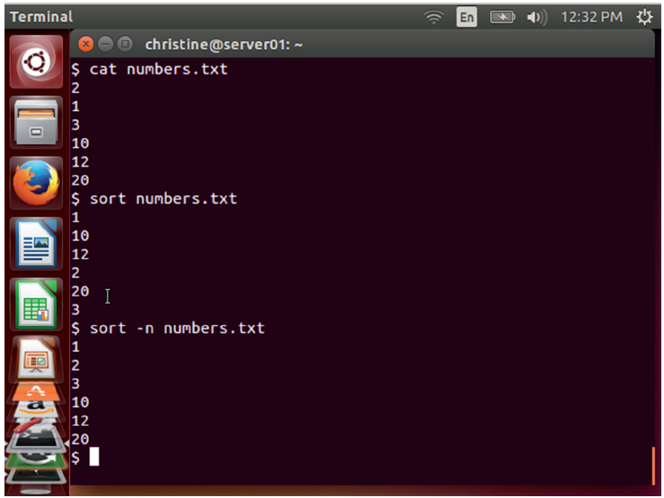
sort Command Example

Slide 19
Common sort Options
Option (long form) | Option (short form) | Description
--dictionary-order | -d | Considers only blanks and alphanumeric characters; doesn’t consider special characters.
--ignore-case | -f | Ignores case (default is to consider case and order capitalized letters first).
--numeric-sort | -n | Sorts by string numeric value.
--output=file | -o | Writes results to file specified.
--reverse | -r | Sorts in descending order (default is to sort ascending).

Slide 20
Searching for and Extracting Data
(continued)
Using grep
Using find
Using wc
Using cut
Using sort
Using cat
Used to
  Display short text files
  Concatenate files together
Does not modify the file

Slide 21
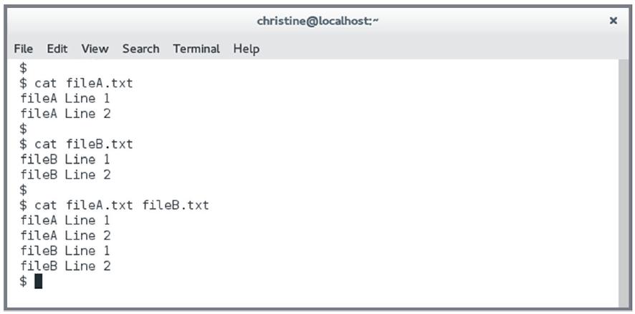
cat Command Example

Slide 22
Redirecting Input and Output
Using Basic Redirection Operators
Standard output - normal program messages & output
Standard error - error messages
Standard input - input into a program
Examples:
  grep david /etc/* > david-in-etc.txt
  grep david /etc/* 2> /dev/null

Slide 23
Common Redirection Operators
Redirection operator | Effect
> | Creates a new file containing standard output. If the specified file exists, it’s overwritten.
>> | Appends standard output to the existing file. If the specified file doesn’t exist, it’s created.
2> | Creates a new file containing standard error. If the specified file exists, it’s overwritten.
2>> | Appends standard error to the existing file. If the specified file doesn’t exist, it’s created.

Slide 24
Common Redirection Operators
(continued)
Redirection operator | Effect
&> | Creates a new file containing both standard output and standard error. If the specified file exists, it’s overwritten.
< | Sends the contents of the specified file to be used as standard input.
<< | Accepts text on the following lines as standard input.
<> | Causes the specified file to be used for both standard input and standard output.

Slide 25
Redirecting Input and Output
(continued)
Using Basic Redirection Operators
Using Pipes
Direct standard output from one program as
standard input into another program
Use the vertical bar (|) between programs
Examples:
  dmesg | grep sda
  cut -f 7 -d ":" /etc/passwd | grep bash | wc

Slide 26
Redirecting Input and Output
(continued)
Using Basic Redirection Operators
Using Pipes
Generating Command Lines
xargs
  find $HOME –name tmp | xargs /bin/rmdir
Backticks (command substitution)
  rmdir `find $HOME –name tmp`
$( ) Format (command substitution)
  rmdir $(find $HOME –name tmp)

Slide 27
Archiving Data
Using tar
Tape archiver (tar)
Archive
  Multiple files collected into a single “package” file
  "Package" file called an archive file
  File extension: .tar
Tarball
  Compressed archive
  File extension example: .tar.gz or .tgz

Slide 28
tar Commands
Command | Abbreviation | Description
--create | c | Creates an archive.
--concatenate | A | Appends tar files to an archive.
--append | r | Appends non-tar files to an archive.
--update | u | Appends files that are newer than those in an archive.
--diff or --compare | d | Compares an archive to files on disk.
--list | t | Lists an archive’s contents.
--extract or --get | x | Extracts files from an archive.

Slide 29
tar Qualifiers
Qualifier | Abbreviation | Description
--directory dir | C | Changes to directory dir before performing operations.
--file [host:]file | f | Uses the file called file on the computer called host as the archive file.
--listed-incremental file | g | Performs an incremental backup or restore, using file as a list of previously archived files.
--one-file-system | (none) | Backs up or restores only one filesystem (partition).
--multi-volume | M | Creates or extracts a multi-tape archive.
--tape-length N | L | Changes tapes after N kilobytes.
--same-permissions | p | Preserves all protection information.
--absolute-paths | P | Retains the leading / on filenames.

Slide 30
tar Qualifiers
(continued)
Qualifier | Abbreviation | Description
--verbose | v | Lists all files read or extracted; when used with --list, displays file sizes, ownership, and time stamps.
--verify | W | Verifies the archive after writing it.
--exclude file | (none) | Excludes file from the archive.
--exclude-from file | X | Excludes files listed in file from the archive.
--gzip or --ungzip | z | Processes an archive through gzip.
--bzip2 | j | Processes an archive through bzip2.
--xz | J | Processes an archive through xz.

Slide 31
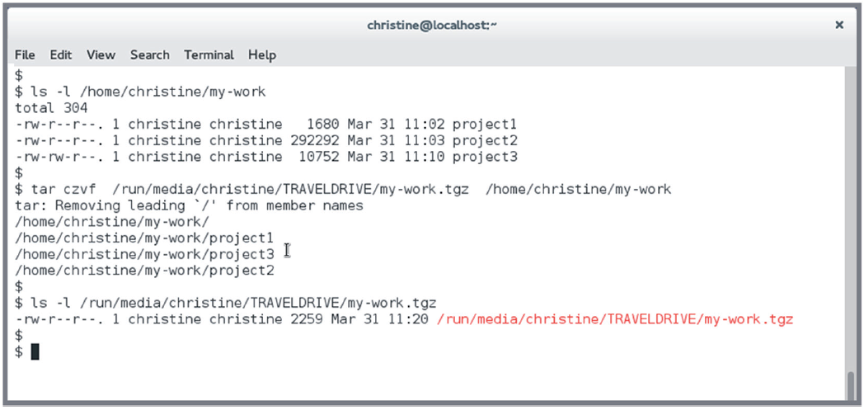
tar Example

Slide 32
Archiving Data
(continued)
Using tar
Using Compression
Lossless vs lossy compression
Linux compression utilities:
  gzip
  bzip2
  xz

Slide 33
Compression Programs
Compression program | Uncompression program | Filename extension
gzip | gunzip | .gz
bzip2 | bunzip2 | .bz2
xz | unxz | .xz

Slide 34
Archiving Data
(continued)
Using tar
Using Compression
Using zip
Provides “tarball-style” files for outside of Linux
Called zip archive
Examples:
  zip newzip.zip afile.txt figure.tif
  unzip newzip.zip

Slide 35
Common zip Options
Option (long form) | Option (short form) | Description
N/A | -0 through -9 | Sets the amount of compression.
--delete | -d | Deletes the specified files from the archive file.
--encrypt | -e | Encrypts the archive with a password.
--freshen | -f | Updates files in an archive if they’ve changed since the original archive’s creation.
--fix or --fixfix | -F or -FF | Performs repairs on a damaged archive file.
--filesync | -FS | Updates files in an archive if they’ve changed since the original archive’s creation and deletes files from the archive if they’ve been deleted on the filesystem.

Slide 36
Common zip Options
(continued)
Option (long form) | Option (short form) | Description
--grow | -g | Appends files to an existing archive file.
--help | -h or -? | Displays basic help information.
--move | -m | Moves files into the zip archive; that is, the original files are deleted.
--recurse-paths | -r | Includes files and subdirectories inside directories you specify.
--split-size size | -s size | Creates a potentially multi-file archive, with each file no larger than size bytes.
--exclude files | -x files | Excludes the specified files.
--symlinks | -y | Includes symbolic links as such.

Slide 37
Common unzip Options
Option | Description
-f | Freshens files from the archive; that is, extracts only those files that exist on the main filesystem and that are newer in the archive than on the main filesystem.
-l | Lists files in the archive but does not extract them.
-p | Extracts files to a pipeline.
-t | Tests the integrity of files in the archive.
-u | Updates files; similar to -f, but also extracts files that don’t exist on the filesystem.
-v | Lists files in the archive in a more verbose format than -l does.
-L | Converts filenames to lowercase if they originated on an uppercase-only OS, such as DOS.
-n | Never overwrites existing files.
-o | Overwrites existing files without prompting.

